Slide 1
Arctic Spark
Software Architecture Design

Slide 2
Temperature thresholds and Start/Stop commands are the only user required actions
All other commands and responses occur internally while providing constant feedback to the user

Slide 3
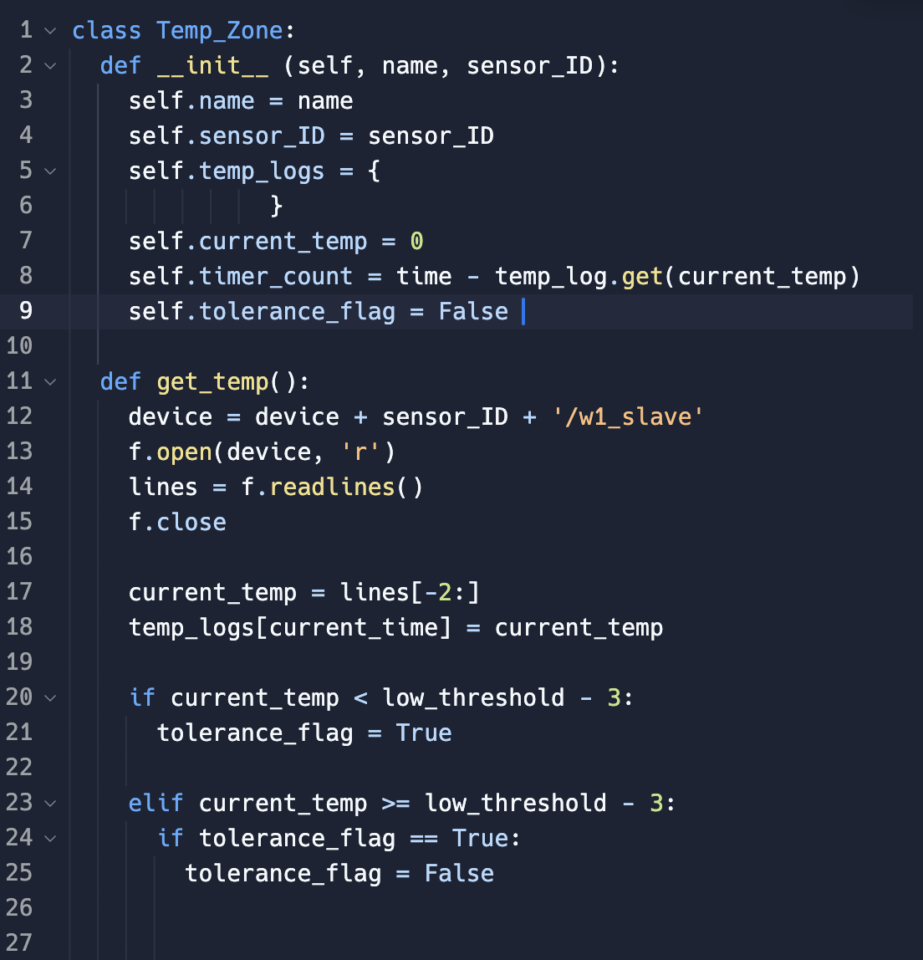
Thermal Zone Data Structure Design
Each thermal zone is committed within a class data structure which stores the following information:
Sensor ID
Unique factory ID of each sensor
Temperature Tracking Log
Database storing each temperature reading and its corresponding time stamp
Time Elapsed Since Last Update
Tolerance Threshold Flag
Indicates if zone is nearing or outside of climate range limits and requires thermal modulation
Additional functions to receive current readings, activate required thermal methods and optimize output of data

Slide 4



Software Function Workflow
1. User inputs upper and lower temperature boundaries and starts thermal monitoring
Min 40º F
Max 120º F

Slide 5
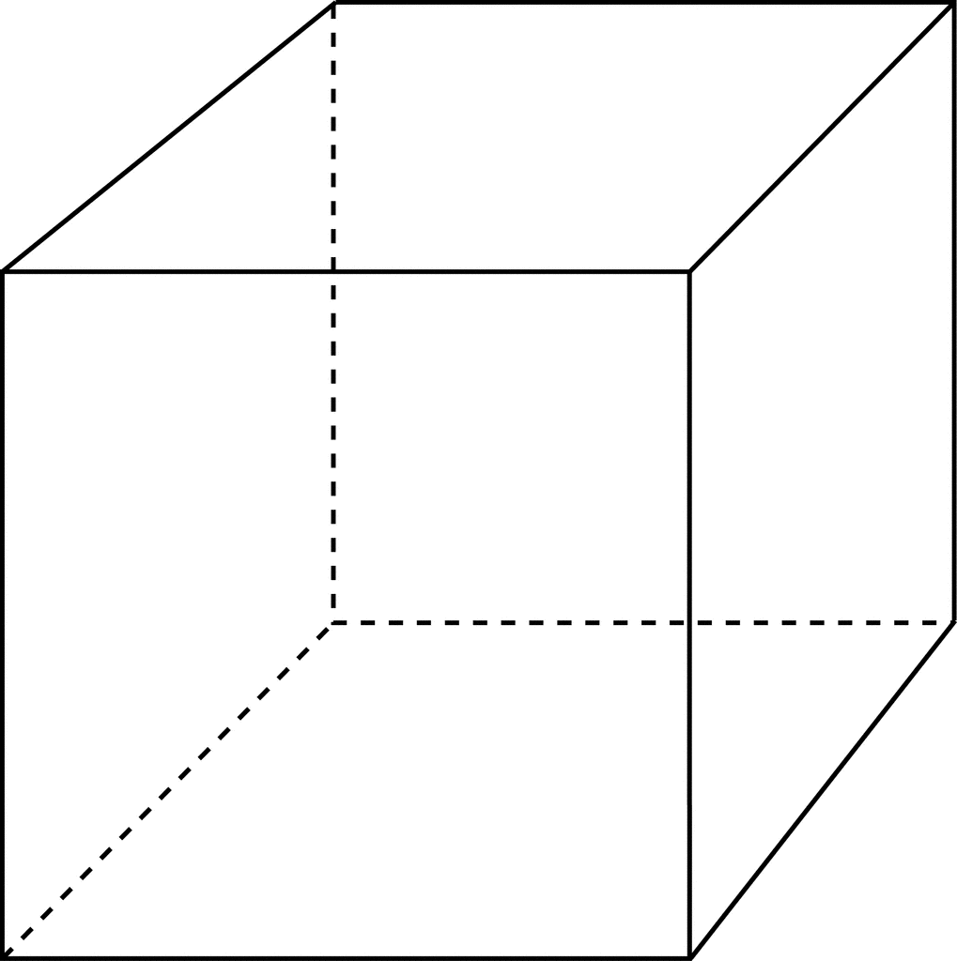

Software Function Workflow
1. User inputs upper and lower temperature boundaries and starts thermal monitoring
Min 40º F
Max 120º F
2. System immediately contacts all sensors and receives temperature readings from all thermal zones. Zones out of our nearing temperature thresholds are flagged.
TZ 3
35º
TZ 1 58º
TZ 2
41º

Slide 6

Software Function Workflow
1. User inputs upper and lower temperature boundaries and starts thermal monitoring
Min 40º F
Max 120º F
2. System immediately contacts all sensors and receives temperature readings from all thermal zones. Zones out of or nearing temperature thresholds are flagged.
TZ 3
35º
TZ 1 58º
3. Flagged zones are communicated to the heating element which provides localized, thermal modulation to desired zones.
{ TZ2, TZ3 }
TZ 2
41º

Slide 7
Software Workflow
4.. System timeout occurs and the next iteration of temperature readings is sensed and stored.
Min 40º F
Max 120º F
5. Flag indicators are updated as required, in addition to heating commands
TZ 3
37º
TZ 1 56º
{ TZ2, TZ3 }
{ TZ3 }
TZ 2
45º

Slide 8
Software Workflow
4.. System timeout occurs and the next iteration of temperature readings is sensed and stored.
Min 40º F
Max 120º F
5. Flag indicators are updated as required, in addition to heating commands
TZ 3
37º
TZ 1 56º
6.. Steps 2 - 5 are repeated until the user issues a Stop command or alters the temperature boundries
{ TZ 3 }
TZ 2
45º

